Slide 1

SES/SRM Webinar Presentation 3 Establishing the SRM
in a Country Office
Notes:
Welcome everyone to this SES/SRM webinar on establishing the Stakeholder Response Mechanism in a Country Office.

Slide 2
Outline
Designing the SRM: UNDP staff input
  The Country Office Focal Point
Setting up the SRM in a Country Office
  Steps and elements
  Working with Implementing Partners
  Outreach to project stakeholders
Notes:
Today we will be talking about how to set up the Stakeholder Response Mechanism in a country office.
To begin, we will review some of the design considerations that your colleagues suggested when we were developing the SRM, and which we think are well reflected in the SRM design. And we will talk about what the SRM consists of and how to put it together.
We will look specifically at the role of the country office focal point and at how you work together with implementing partners to promote the alignment of their processes and engagement mechanisms with the SRM, and to see the SRM as one end of the continuum of options for stakeholder engagement.
And likewise we'll discuss outreach to project stakeholders who might raise concerns and grievances and who need to understand what their options and opportunities are, including the SRM. And again contextualizing the SRM at one end of a continuum of opportunities for engaging with the UNDP on its projects.

Slide 3
Feedback from UNDP Staff on the Design of the SRM
Makes sense to create the SRM, to meet global expectations and support UNDP’s SES
Most issues/concerns handled appropriately through normal project management
Avoid highly formal/cumbersome internal interactions among HQ, RBx/RSC and COs
Watch out for “opening the floodgates” of complaints
Provide support for the roll-out and implementation
Notes:
First, a few points of feedback from UNDP staff that significantly influenced the design of the SRM.
We surveyed staff in country offices, regional bureaus, regional service centers, and at headquarters to hear their thoughts on what would make this mechanism as useful as possible. Main points of feedback included:
It makes sense to create the SRM: first, it makes sense to create the SRM in the context of increasing international expectations for multilateral development institutions to have such mechanisms. In the context of UNDP’s rollout of the social and environmental standards, it would be appropriate to have a feedback and response mechanism to ensure that UNDP is well aligned with all of those standards in all of their projects.
Most issues/concerns are handled appropriately through normal project management: When it comes to the supplemental role of the SRM, it is very important to keep in mind that most issues and concerns are being handled appropriately in nearly all instances and nearly all of the time, through normal project management. Therefore, the SRM must be seen as a fall back for the few instances where those management tools and procedures are not effective at addressing stakeholder concerns.
Watch out for over-formalizing or making too cumbersome a set of internal interactions among HQ, RBx/RSC and COs. Related, this SRM should not be so formal or cumbersome in its design or implementation that it creates tangles among country office, regional, and headquarters levels. On the contrary, it should be clear which level is in the lead and which other actors are in supplemental, supporting roles. As will be discussed further, this mechanism is designed for the Country Office to take the lead with few exceptions.
Watch out for “opening the floodgates” of complaints to the SRM: Another comment we heard is that this mechanism should not encourage stakeholders with concerns to run directly to it or to exaggerate or create new concerns simply because the mechanism is available. Therefore, communication around the supplemental role of the SRM, and the reminder that the primary avenues for raising concerns remain with the implementing partners and with UNDP’s project management, will be very important.
Provide support for the roll-out and implementation: Finally, we heard it is important to provide country offices with support, and particularly to the staff in the country office who are dedicated to manage the stakeholder response mechanism, so that they are confident individually and, at an office level, have the capacity they need to address the concerns that are raised and also know what resources are available to them at the regional and corporate levels when they need them. This webinar, along with other resources, are part of the support that we intend to provide.

Slide 4
Expectations for the SRM Focal Point
Member of the management team, with substantial responsibility for QA
Highly effective communications, problem solving and interpersonal skills
Ability to coordinate SRM responses among UNDP project managers, other staff and management involved in SRM response, SRM requester, and other external stakeholders involved in the case
Notes:
As we move from design of the SRM to implementation, it is important to acknowledge the central role of the SRM country Focal Point. There are three main expectations for the person in this role in each country office.
First, the person should be a member of the management team, preferably someone with substantial responsibility for quality assurance, and it is particularly useful if the person is engaged in reviewing projects and programs for adherence to social and environmental standards.
Second, at a skill level, the person should be highly effective as a communicator, have good problem solving skills, and good interpersonal people to people skills in situations where emotions may run high, perceptions may be divided, and in situations where a cool head, friendly manner, and a can do attitude are key to making progress.
Third, the person should have the ability and authority to coordinate the response to requests. That includes internally in the country office, including program managers and staff who could be on the program or operations side. Where necessary, the person should also have the mandate to involve senior management in the country office, the regional bureau, and the corporate level. The focal point will also need to coordinate with external actors including the SRM requester (the person/group who has the concern), with the implementing partner, who will likely be involved in most responses, and conceivably, with other stakeholders such local government or with other community groups involved in the project.

Slide 5
SETTING UP THE SRM IN A CO:
STEP BY STEP
Month 1
Identify a Country Office Focal Point (CFP)
CFP completes on-line orientation
CFP makes all programme staff aware of SRM procedures, and requirements for informing implementing partners and project stakeholders
CFP clarifies procedure for entering SRM requests in the SRM Case Management System
Notes:
Turning now to the step by step process of setting up the SRM.
The first step has largely been accomplished and a number of you listening to this webinar are likely people identified in your office as the Country Office Focal Point. That is the first step that most resident representatives have already completed.
The person who is designated as the Country Office Focal Point should complete an online orientation in the first month. Right now that is focused on the webinars; later, into 2015 and beyond, there will be additional training materials and resources available to you.
Once the CFP is oriented, it is important for the CFP to communicate the key points about the SRM—what is it, when can stakeholders use it, and how do stakeholders use it—to all program staff, and potentially to operational staff as well, so that all are aware of the SRM, and, very importantly, so that program staff working with implementing partners and project stakeholders understand that they will need to communicate the existence and availability of the SRM to project stakeholders.
Finally, in the initial month, the CFP should clarify the procedure for entering the SRM request into the case management system. The case management system will be rolling out shortly and it will come with guidance on the procedure. It is important to have clear understanding of who in the Country Office can enter data into the case management system.

Slide 6
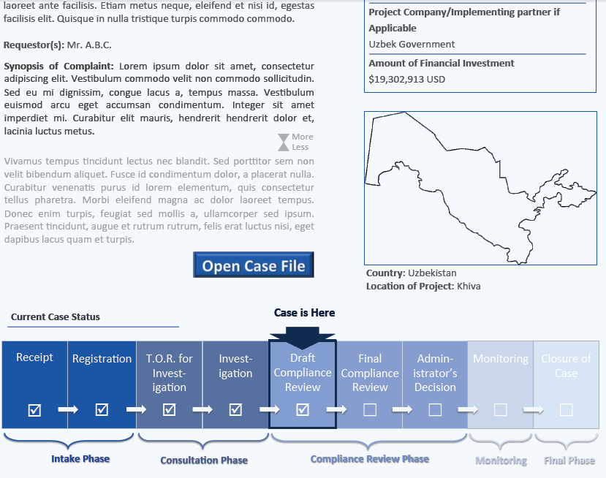
Notes:
To give you sense of how the case management system will look and work, this is an image of what will be available internally at UNDP for the CO and counterparts at the regional level and in HQ SRM Support Unit--which is part of BPPS—to see.
For any given case, the case management system will show when the case was opened, what project it relates to, and where it stands in terms of the issues raised, the response UDNP made so far, and the current status of the case.
The bottom of the graphic identifies the set of steps that should be followed in every case, and flags where the case is at in that process. This screen will be available only internally to UNDP.

Slide 7
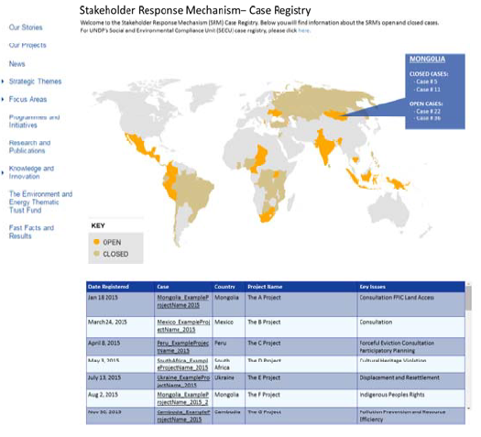
Notes:
It is also important to note that information about the SRM and about particular cases will be available externally to anyone who is interested in understanding what is happening with the SRM and what cases it has addressed and is addressing.
This is part of UNDPs overall corporate commitment to transparency and accountability. If you look at this externally available page, you will see it is a map of the world and you can click on any country. You can see if there have been any SRM cases there, which are closed or open, and you can look at the bottom and see basic information about each SRM case: the date it was registered, the case name, the country, the project it relates to, and where it is in terms of substantive issues.
It is important to recognize that the information here is meant to be significantly less detailed than what is available internally. In particular cases, when the case is closed, it may be appropriate to add some information and documentation about the issues that were raised and how they were resolved. Those judgments will be made case by case within some general guidelines on appropriate levels of transparency and confidentiality.

Slide 8
SETTING UP THE SRM IN A CO:
STEP BY STEP
Month 2 and ongoing
CFP considers whether any projects in implementation or in the CO pipeline (concept document up through appraisal) pose high grievance risks
For high risk projects, CFP and project managers discuss implementing partner response capacity, and options for strengthening or supplementing it where needed
Over time, as patterns of stakeholder grievance across the UNDP portfolio become clearer, CFP and programme managers can identify opportunities for UNDP to build implementing partners’ organizational/sectoral/national grievance mechanisms
Current FCPF/UN-REDD Guidance on Establishing and Strengthening Grievance Redress Mechanisms: http://tinyurl.com/opj3v5m
Notes:
The second set of steps in setting up the SRM focus on grievance risk in the portfolio of current projects and projects in the pipeline.
What we mean is that the CFP should take a look at the portfolio with project managers and ask "where might we be seeing significant social and/or environmental impacts in these projects where the risks are there and cannot be prevented?.”
In projects that pose high risks, the follow-on question is ‘how well positioned is our project implementing partner to respond to stakeholder concerns and grievances, if indeed those impacts materialize?” Where the implementing partners capacity seems to be low, that should trigger a follow-on set of actions by the Project Managers to go and talk with the implementing partners about the risk and their capacity, and to think together about ways to strengthen or support it.
The Project Managers might find ways to work directly with implementing partners or organizations, or they might look at national institutions--for example a national human rights office or ombudsman's office--as options for project stakeholders if the implementing partner organization does not look like a good place to locate grievance response capacity. Or, it might be most effective to strengthen a project mechanism in the short term--for example the project board--and make it clear to stakeholders that is a place they can go to raise their concerns.
In any case, the main point is for the CFP with project managers to look at the likely social and environmental impacts, to ask in high risk projects how well positioned is the partner to handle grievances and concerns and, where the partners capacity seems week, to create a plan of action to strengthen or supplement it.
In addition, it is important to note that over time as UNDP gains more experience in identifying grievance risks, in developing mechanisms to prevent or address those grievances, and where it gains a broader perspective across the portfolio on how grievances play out, it may become clear that there are specific thematic or sectorial areas, or in geographic areas, where there is a higher concentration of grievances and where the capacity to respond to them seems to be low. In those instances, UNDP may have an opportunity to prevent grievance more systemically and to propose grievance mechanism strengthening as a service line to national counterparts. In any case, it will be more credible for UNDP to make that proposal the better UNDP has demonstrated its capacity to manage the SRM and to work proactively with the implementation partners on their grievance management.
Finally, just to note that some guidance is available to you on assessing grievance risk and in building up partners grievance response capacity. It is available through the Forest Carbon Partnership and UN REDD website. You can see it at the bottom of this webinar slide as a URL. The guidance is written specific to the context of forests but it is broadly applicable to many other contexts as well.

Slide 9
SETTING UP THE SRM IN A CO:
STEP BY STEP
Month 3
CFP ensures that project staff conduct outreach on high risk projects, informing partners and stakeholders of grievance options and UNDP SRM and Social and Environmental Compliance options
CFP generates report to Regional Bureau and HQ (BPPS SRM unit) on establishment of SRM in CO
CFP ensures that CO Web site includes link to joint SRM and Social and Environmental Compliance Unit (SECU) Web page, with explanation (using text from HQ)
SRM officially launches
Notes:
The last set of steps in setting up the SRM in a country office include both an outward facing and an inward facing component.
On the outward facing side, it is important to conduct outreach both to project implementation partners and stakeholders, particularly for projects identified as high risk whether they are under implementation or in the pipeline.
The outward facing outreach is to let both implementing partners and project stakeholders know about the existence of the SRM and to contextualize it so they understand what it is, and that it is a resort to be used only after regular channels of communication with the implementing partner and with UNDP project management have not proven to be effective in responding to concerns that are raised.
In the outward facing outreach process, it is also useful and important to let the stakeholders know about the social and environmental compliance option, which is discussed in more detail on a separate webinar. Instead of doing parallel processes of outreach, it is good to communicate to stakeholders and implementing partners the range of stakeholder engagement options and grievance redress options that are available to them, including both the SRM and the social environmental compliance tract.
We will have some questions for you in a minute about how both implementing partners and project stakeholders might respond to information about the SRM and how you might prepare yourself to be effective in communicating with them about grievance, risk, and response.
On the inward facing side, when the outward outreach to stakeholders has been substantially completed, it is time for the CFP to generate a brief report to the RBx and HQ, specifically the BPPS SRM Unit, noting the steps that have been taken, and that the SRM is ready to start in that office. Finally, before launching, you need to include a link on the country office website to the joint SRM and social environmental compliance unit or SECU website where people file grievances and ask for a response. HQ will provide text that can be used on the Country Office webpage.
The expectation is to have the SRM available but used infrequently because there is effective stakeholder engagement completed in more proactive ways nearly all of the time and in nearly all project contexts. Nonetheless, when the SRM goes live in the Country Office, it will be very important that the Country Office is in fact ready. In the unlikely but non-zero event that a SRM request is received by the Country Office in the first year or so, it will be very important to demonstrate UNDP's commitment to be responsive, to be effective in the response, and to be open in the response to any SRM request that is received. Be sure that you're ready when you put that website up and go live, and as you conduct that outreach, because it will be in your interest as well as UNDP’s Corporate interest.

Slide 10
Outreach to Implementing Partners
What concerns might implementing partners have about UNDP’s formalization of grievance management through the SRM?
    Assessing the project’s grievance risks
    Assessing the partner’s response capacity
    Ensuring that project stakeholders have information about project grievance response mechanism(s) and the SRM
    Impact of SRM requests on project activities, timeframes and outputs
    Others…
Notes:
As I mentioned, In the final stage of establishing the SRM at the country level, one very important task is to reach out to implementing partners for projects in the pipeline to talk to them about grievance risk and how to manage the risks, and to inform them about the SRM and its availability as a supplemental response mechanism.
When you have those conversations with implementing partners, we think it is likely that they will have some concerns about the implications of the conversation and UNDP’s sense of the need for effective grievance prevention and response. Please take a few seconds to think about the kinds of concerns implementing partners might have as UNDP seeks to engage them in a healthy conversation about risks and grievance response mechanisms.
A few things occur to us as potential areas of sensitivity:
First is the assessment itself from the screening of the grievance risk. Do UNDP and the implementing partner actually see eye-to-eye on the potential social and environmental impacts? On the stakeholders who may be impacted? Or on the actions those stakeholders might take to raise their concerns?
The second area could be the conversation about the implementing partners capacity to respond to those grievances or concerns and whether they have a mechanism, and whether such a mechanism is credible to project stakeholders. Do stakeholders believe they’ll get a response? Are they concerned they might face some form of retaliation if they raise a concern?
The third area of sensitivity might be around providing information to project stakeholders about the availability of recourse—the avenues or mechanisms for redress of concerns. Implementing partners might either want to be clear that their own mechanisms are the ones that stakeholders should use--they might be sensitive about the option for stakeholders to go to UNDP. Or on the contrary they might be very eager to direct all stakeholder concerns directly to UNDP and not take responsibility for them. In either case, this is a topic for dialogue and clarification about the supplemental nature of the SRM.
The last area that might be of significant concern is whether and how UNDPs response to requests received through the SRM might affect project activities, time frames, specific outputs, etc. Project implementing partners might want to have a conversation with the UNDP about the actions UDNP might take in response to specific, hypothetical, grievances and to get some assurances from UDNP, or at least some clarification, about circumstances under which UNDP might seek to alter agreed project activities.
In any case, we think it is important, for projects under review and where there are significant grievance risks identified, that staff think ahead about the conversations they’ll need to have with implementing partners and to come to those conversations well prepared to explain why UNDP is focusing on this issue of grievance risk, to be clear about the existence of the SRM, to be constructive in responding to implementing partners’ concerns, and to be clear that this is now a corporate requirement for UNDP to ensure the avenue exists and is used in a supplemental way.

Slide 11
Discussion:
Outreach to project stakeholders
What issues might arise as the CO and implementing partners inform project stakeholders about project grievance mechanisms and the SRM?
    Reaching relevant stakeholders?
    Communicating clearly and effectively about GRMs and SRM?
    Managing stakeholder concerns and expectations about the accessibility, credibility and effectiveness of project GRM and the SRM?
    Others?
Notes:
Along with the outreach to implementing partners, and in most cases following some development of an understanding and agreement with the implementing partners on how best to approach project stakeholders, the other form of outreach that UNDP staff need to undertake to establish the SMR is outreach to the actual stakeholders of projects in the pipeline. This outreach should be done to inform them, particularly in high risk contexts, about the existence of the SRM and to contextualize the SRM among other options for stakeholder engagement, participation, and dealing with their concerns.
Here again, please take a few seconds to reflect--what do you think some of the project stakeholders might be thinking about or concerned about as they hear about grievance, risk, and options for redress from UNDP and implementing partners?
From our perspective, there are a few important issues to consider as you develop and execute this stakeholder outreach.
One important question is targeting and reaching the key stakeholders, those who are likely to be impacted and who may be in most need of information and support in understanding when and how to raise those concerns. We think it will be necessary to pay special attention to vulnerable and marginalized groups that may not have access normally, or confidence in, public institutions to raise their concerns. This could be women, youth, indigenous peoples, very poor urban traders in the informal sector, etc. There are many possibilities for challenge in reaching stakeholders who may be negatively impacted.
The second issue is in engaging the stakeholders in a constructive conversation about this question of potential impacts and how to raise their concern if they are impacted. Ideally, you want to communicate with the stakeholders jointly with the implementing partner, and you want to contextualize the SRM at one end of a continuum of stakeholder engagement, being sure that the stakeholders understand the full range of opportunities for participation with the grievances mechanisms as a last resort, and among the last resorts, the SRM is the last of the last.
At the same time, we think it is important to be clear with them in setting good expectations about both the viability of these avenues for raising their concerns and, at the same time, managing their expectations about what will happen if they do raise a concern. You want to provide reassurance that there will be a response. You and the implementing partner should have a clear agreement about communicating that there is and there will be no risk of retaliation. Equally, it is important to say that not all concerns raised by a stakeholder will result in a resolution that is fully satisfactory to a stakeholder. There are instances in which there is a greater good to be provided, there is a cost or an impact to a stakeholder from achieving a greater benefit, and it is not possible to fully neutralize or avoid that impact. The commitment that can and should be made is to leave those stakeholders, at a minimum, no worse off than they were in the absence of the project, and to be compensated in a way that leaves them whole even if the impact itself is unavoidable.
There may be other concerns that stakeholders raise that are important to anticipate and address. We encourage good detailed conversations within UNDP and between UNDP and implementing partners to anticipate the types of concerns that may come up as grievance mechanisms and the SRM are explained and to be ready with constructive and clear responses.
This concludes the overview of steps you need to take to establish an SRM in the CO. In a subsequent webinar, we’ll talk more about what to do when you receive a request for the SRM, the steps in managing an individual case. Before we wrap up. I want to remind you of options and opportunities you have for learning more and for giving us more feedback.

Slide 12
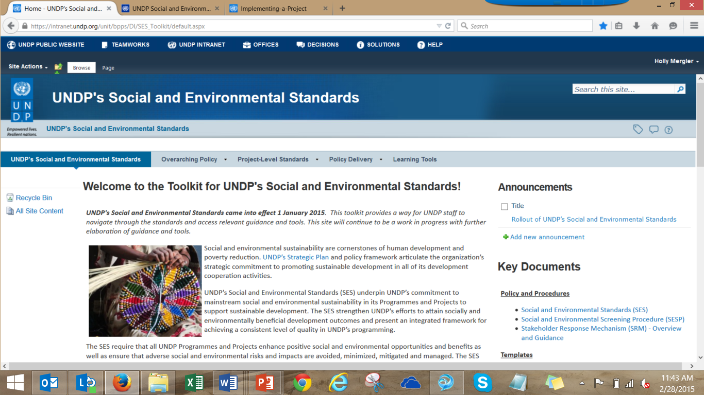
Learn More
SES Toolkit: intranet.undp.org/unit/bpps/DI/SES_Toolkit
SES Public Website: www.undp.org/ses
SECU/SRM Public Website: www.undp.org/secu-srm
Notes:
There are both internal and external resources available to you to learn more and also to provide information about the SRM external counterparts.
Internally, there is the UNDP website with substantial amounts of information on social and environmental standards overall, including assessment of grievance risks in the context of the SES.
Externally, there is a public website about the SES and there is a public website for SECU, the compliance arm of the accountability mechanism and the stakeholder response mechanism. That website provides guidance and a form for input of a request that is available to any potentially affected stakeholder in any UNDP project. We encourage you to review the SRM information on that website so you have a good understanding of what a stakeholder who wants to use this mechanisms might find if he or she were to go looking on the internet.

